Slide 1
Conservation Update
Robert Hooke’s Micrographia
London:1667
Notes:
Hello, my name is Eliza Gilligan and I am the Conservator for University Library Collections at the University of Virginia. This slide show is a “re-broadcast” of a presentation I made at a library staff “Town Meeting” on September 16, 2011. I hope my notes to the slides fill in the gaps left by the transition from live presentation to this show, but if you have a question, please feel free to email me <emg3b@virginia.edu>.
I’d like to share a little bit of information about the process of conservation treatment and also a little bit of information about what a unique opportunity conservation treatment provides in terms of examining the components of a book, using my recent treatment of Robert Hooke’s Micrographia as an example. Conservation of this title and many volumes from our circulating collections were made possible by a generous gift from Kathy Duffy, friend of the University Library

Slide 2
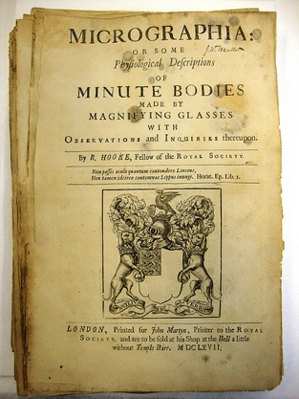
What is Micrographia?
The landmark publication that initiated the field of microscopy. The first edition was published in London in 1665. Robert Hooke described his use of a microscope for direct observation, provided text of his findings but most importantly, large illustrations to demonstrate his findings.
The UVa Library copy is from the second issue printed in 1667.
Notes:
This book was brought to my attention by a faculty member of the Rare Book School who uses it every year in her History of Illustration class. Her notes on the book said “somewhat precarious condition”. The book was indeed in poor condition. judging from the staining and tide lines and the lack of any covering material, I would guess that the book went through some very dramatic water-based event. We have no acquisitions records for this book, and it is not listed in the 1825 catalog, so its provenance is something of a mystery.

Slide 3
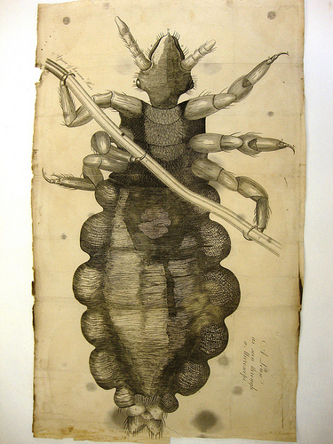
The louse
Notes:
This is the famous louse illustration, a remarkable example of engraving as well as scientific observation. Note the caption in the right claw of the louse “a piece of human hair”. Hooke is giving us a delightful peek over his shoulder and showing us the scale of his observations all at once.

Slide 4
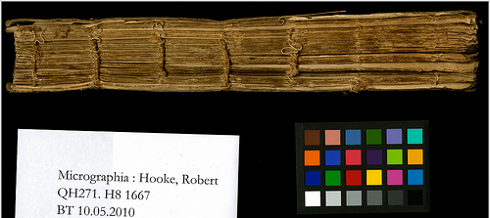
How does conservation work?
Assessment:
  What does the book need?
  What can be done?
  How will the book be used?
Notes:
In preparing for conservation treatment, the book is evaluated for damage, in this case the book has lost its covering material (I found a very small remnant of the leather cover under the front endsheet), the sewing is completely broken, the sewing supports are almost gone, there is staining from liquid and mold and quite a bit of dirt on the pages. The good news is that the paper was strong enough to withstand the cleaning, washing and mending necessary for treatment. The book is used regularly for in-class and hands-on demonstrations so getting it in good working order is crucial.

Slide 5
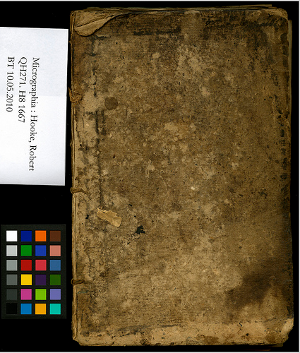
How does conservation work?
Research:
  Is the current binding accurate?
  Is there significant provenance information that needs to be retained?
  What else do we know about the book?
Notes:
In the case of the Micrographia, it was really hard to determine the accuracy of the binding since there was so much damage. Again, we had no provenance information, no acquisition records; the title was not listed in the 1825 catalog, nor was it listed among the surviving books from the 1895 Library fire. I made plans to visit the Folger Library which also has a copy of the 1667 Micrographia, initially I thought I would be researching binding styles for use in binding the UVa copy, but as my research continued, it became apparent that our book contained many mysteries.

Slide 6
How does conservation work?
Treatment proposal
Approval from head of Special Collections
Photo documentation of condition prior to treatment
Proceed!
  But always keep your eyes open!
Notes:
All of the previously listed questions inform the treatment proposal which is presented to the Head of Special Collections for approval. Once I had my approval I proceeded with dis-binding the remaining bits of sewing and preparing for treatment. While it is a fairly simple process to take a book apart, it is crucial that you stay focused during the process and take notes on any anomalies you find, this is the last time the book will be in “original order” and you will very likely see new details come to light.

Slide 7
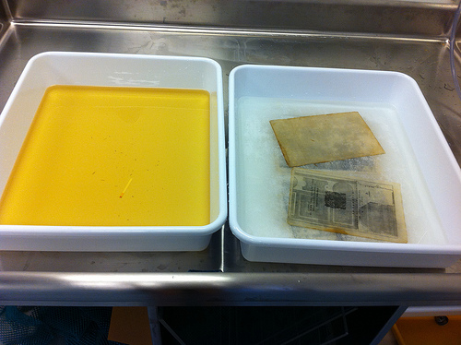
Dry cleaning & washing, mending
Notes:
The tray on the left is the first water bath after the pages have been moved to the second bath on the right. The water starts out clear and pH neutral, but after an hour the water was pH 5.5 and yellow from all of the acidic degradation products in the water.
I proceeded with the cleaning and mending since these are the steps I can do that do not fix anything in place. I also proceeded with my binding research, planning a trip to the Folger Library to see their 1667 issue and then to the Chemical Heritage Foundation to see their 1665 first edition.

Slide 8
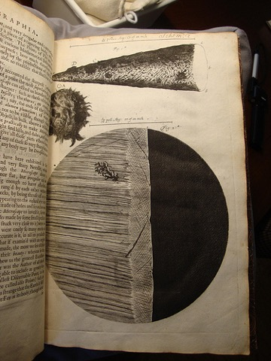
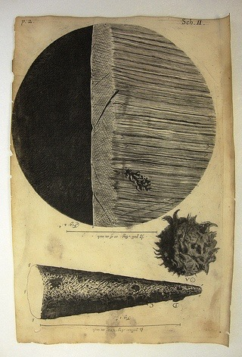
Putting it all back together
Chemical Heritage Foundation -1665
UVa Library -1667
Notes:
What I found when visiting both the Folger and the CHF is that the UVa copy of Micrographia has remarkable differences in the plates. I have not been able to find these differences in any other copy of Micrographia, (I’ve looked at the online editions at the University of Wisconsin, 18th Century Online and emailed with the librarian at the Library Company) although I have had a lot of fun trying. In this example you can see that the picture on the right is an upside down version of the one on the left. However, the plate marks are at the top of the UVa plate which suggests that the engraver made a mistake, but if the 1665 is a first edition, does it mean that the plate used for the UVa 1667 is a poorly executed copy?

Slide 9
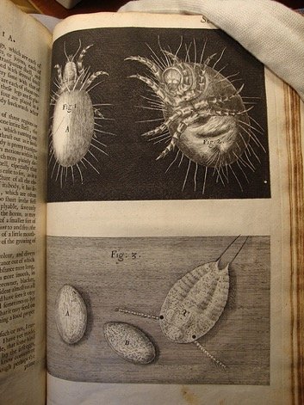
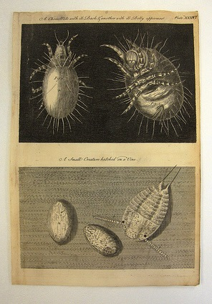
cheese mites
Chemical Heritage Foundation- 1665
UVa Library 1667
Notes:
There really is such a thing as cheese mites, and these engravings are scarily accurate, go ahead, search Google Images for “cheese mites”! Note the differences in the plates and in their captions. The UVa copy of this plate looks very similar to the 1754 “Restaurata” re-print of Micographia but is not quite a match, could our 1667 actually be a working copy for production of the 1754 reprint?

Slide 10
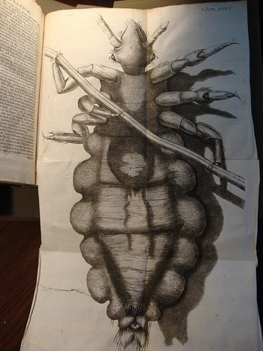
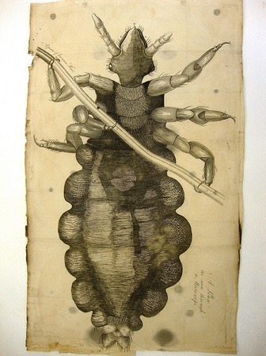
And the louse!
Chemical Heritage Foundation-1665
UVa Library 1665
Notes:
This famous illustration has many wonderful differences from every edition I’ve consulted. Note the differences in the captions, the shadow, the highlighting on the body of the louse and if you can zoom in on the pictures you may also be able to see the differences in the reference letters on the body of the louse.

Slide 11
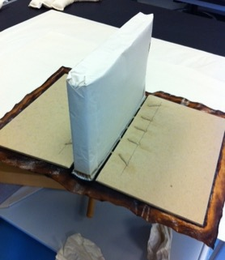
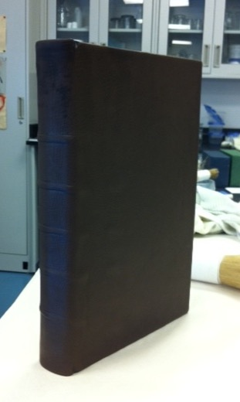
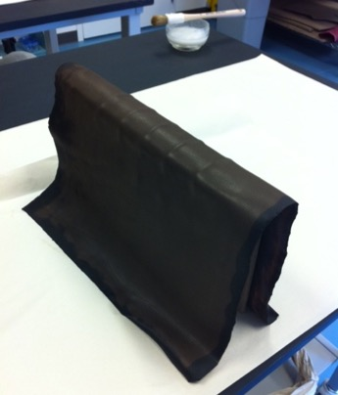
Notes:
After all of my research, I did sew and bind the book, putting the plates in their correct places. There were some I had to move since they were originally bound in the wrong place. Those changes, along with all of the other anomalies I found are part of my treatment records and will be available to future researchers. I will continue to research the unique details of the UVa copy of Hooke’s 1667 Micrographia. These slides show the process of applying the leather cover, with the finished, but not-quite dry book on the right.

Slide 12
the conservation lab blog
http://atthebench-conservation.blogspot.com/
Notes:
I do maintain a blog for the lab, please stop by to see what’s going on. I perform treatment on a regular basis, so there is always something new and exciting to see. And again, if you have any questions, feel free to email me! Thanks, Eliza

